Slide 1

“Efficient Learning on Imbalanced Image set” M. S. Ramaiah Institute of Technology
Presented by,
Shivani Guldas
RIT-Bengaluru
Guided by,
Lincy Meera Mathews
Assistant Professor
RIT-Bengaluru
(Department of Information Science and Engineering)

Slide 2
Agenda
Scope
Problem statement
Objectives
Literature survey
Proposed system
Challenges
Output
References

Slide 3
Scope
Many fields like agriculture, healthcare, industrial system monitoring, behavioral analysis etc make use of image as their data. The data however could have data instances that could be irrelevant , missing or unlabelled.
When the instances of one class is lower than other class then the data is imbalanced and it has to be balanced.
In order to balance the data, oversampling technique is adopted. Five image Enhancement techniques are adopted.

Slide 4
Problem Statement
Real World bi-class Image set own an inherent property of imbalance among the classes. Hence the traditional Learning algorithms tends to bias towards the majority class.
This project aims to eliminate the bias of the classifier towards the majority class. We have incorporated several oversampling techniques to balance the data.

Slide 5
Objectives
To collect imbalanced image dataset
Classify the images
To check system performance
Enhance the images
Improve system performance
Form a balanced image dataset from an efficient classifier.

Slide 6
Literature Survey
Learning from imbalanced data: open challenges and future data(Authors)
In this paper, author discussed about the current challenges being faced with respect to imbalance data in many real time applications-, the methods to tackle the imbalanced data and future direction to deal with imbalance issue.
Classification with class imbalance problem: A Review
This paper presents an overview on class imbalance classification and the inevitable challenges that come with it. It describes the main issues that hinder the classifier performance in managing highly imbalanced datasets and the many factors that contribute to the class imbalance problems.

Slide 7
Literature Survey (Cont…)
Imbalanced dataset Classification and solutions: A review:
This paper discuss five different levels to handle imbalance data, the methods and algorithms that come under each level. Author discussed about various machine learning tools-WEKA, Rapid Miner etc to work to solve imbalance issue. The evaluation metrics is discussed that help in evaluating classifier performance.
A review on image enhancement techniques with its advantages and disadvantages:
This paper discuss different image enhancement techniques for better quality of images and also discuss advantages and disadvantages of every method.

Slide 8
Literature Survey (Cont…)
Classification of emotions from ECG using KNN classifier:
The paper discuss about the features to consider from the images and how important is the feature extraction in order to classify the data. KNN technique is used to classify the data (ECG data medical image set) and the emotions were classified as happy or sad, the performance of classifier was checked with different imbalance ratios and different ‘k’ values.
Review of image enhancement technique:
The authors discussed two approaches to create synthetic images –spatial domain and frequency domain techniques. Comparison was made between the two approaches and the authors felt difficult in conveying which approach is the best one. They also discussed advantages and disadvantages of both the approaches.

Slide 9
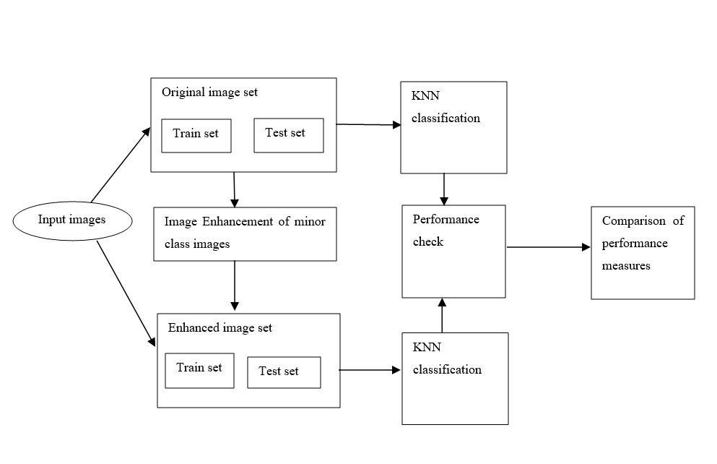
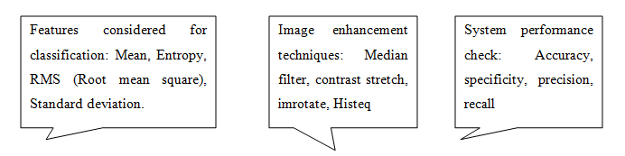
Proposed system

Slide 10
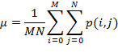
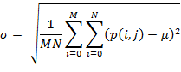
Proposed system-Features Extracted
Mean
The mean is defined as an average of all pixel values of a picture.
p represents pixel value at point i, j of MxN image
Standard Deviation
This normalizes the facts and tell how far our data is from the mean. It is a portion of the spread of a set of values from the average value and also represents dispersion of local regions.
root of pixel ‘p’ at points i, j for MxN image from its mean.

Slide 11
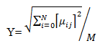
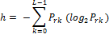
Proposed system-Features Extracted (Cont…)
Root Mean Square
Alias quadratic mean is a statistical measure of the degree of a fluctuating quantity. It is useful when variates are positive and negative. It is the root of mean square value of each row or column or of an entire picture.
Entropy
It is a measure of randomness of a picture used to categorize the surface of a picture. Higher the entropy, higher, the higher miss-categorization. It is a distribution variation in an area.

Slide 12
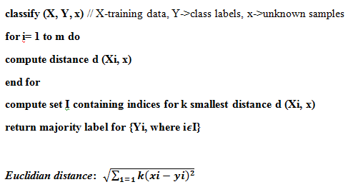
Proposed system-Classification Algorithm- K-NN

Slide 13
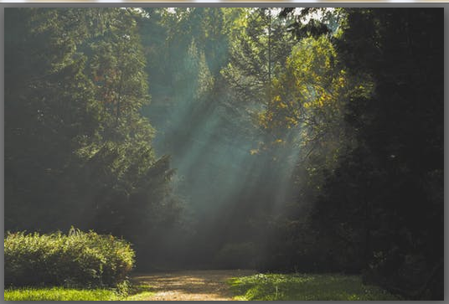
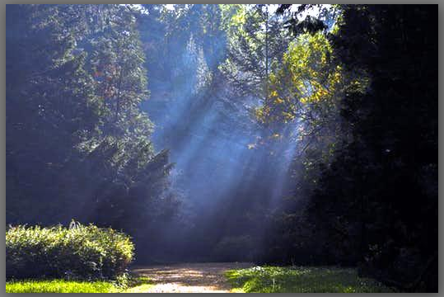
Proposed system-Synthetic Image generation techniques
Contrast Stretch()

Slide 14
Proposed system-Synthetic Image generation techniques-Contrast Stretch(Cont…)
The method improves the image by elongating the range of intensity values of an image and fully utilize the possible values.
It splits the image histogram into two equal parts so that intensities are equally arranged as well.

Slide 15
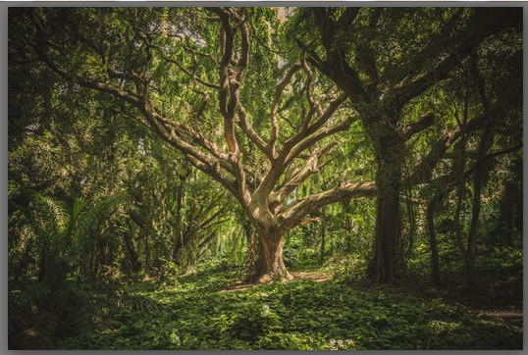
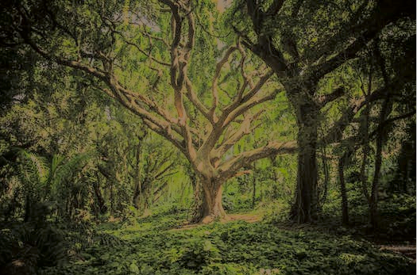
Proposed system-Synthetic Image generation techniques(Cont…)
Brightness preserving Bi-Histogram equalization()

Slide 16
Proposed system-Synthetic Image generation techniques-BPHE(Cont…)
The method is used to protect the brightness of an image. It splits the image’s histogram into two independently equalized parts and the strength of image is equally arranged.

Slide 17
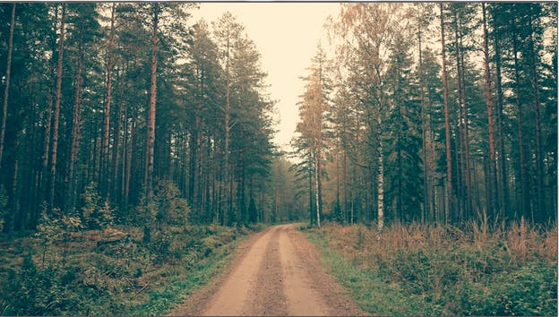
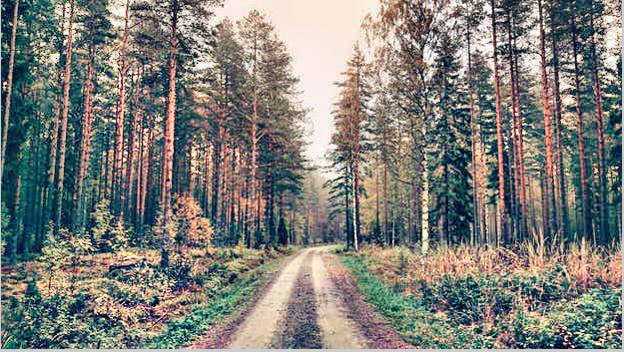
Proposed system-Synthetic Image generation techniques(Cont…)
Adaptive Hist_equalization()

Slide 18
Proposed system-Synthetic Image generation techniques-AHE(Cont…)
This technique is utilized for modifying contrast as a part of images. It varies from Histogram Equalization by versatile strategy that computes a few histograms and every histogram relating to a particular segment of a image.
It redistributes the lightness value in the image.

Slide 19
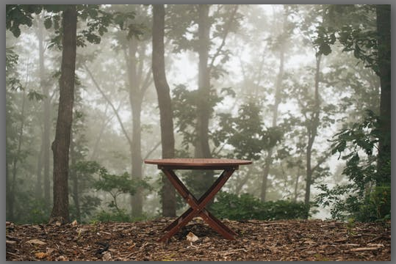
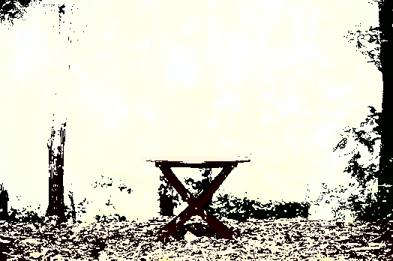
Proposed system-Synthetic Image generation techniques(Cont…)
Contrast Enhancement():

Slide 20
Proposed system-Synthetic Image generation techniques-CE(Cont…)
This technique automatically brighten images that appear dark or unclear. It applies appropriate tone correction in order to deliver improved quality and clarity.
This play an important role in medical applications.

Slide 21
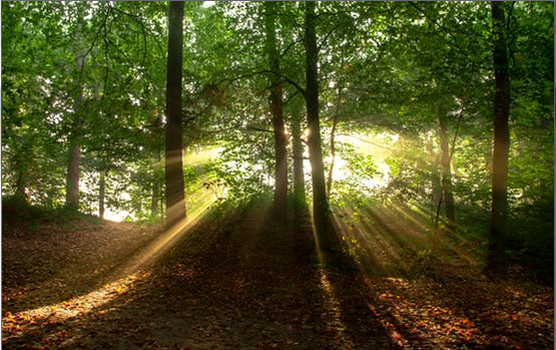
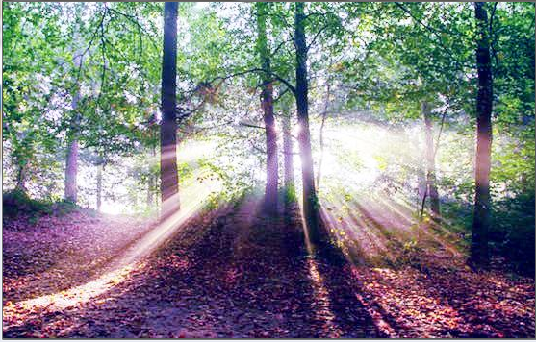
Proposed system-Synthetic Image generation techniques(Cont…)
Histogram Equalization

Slide 22
Proposed system-Synthetic Image generation techniques-HE(Cont…)
This technique will boost the darker images and normalizes the lighting effect.
This method elasticizes the histogram across all the pixels (0-255).
The image detail is compacted to the darker tip of the histogram.
If the grey level at darker tip is expensed in order to uniformly disperse histogram then more the image is unblemished.

Slide 23
Proposed system-System performance measures
Recall
It is the ratio of correctly predicted positive pixels as positive samples out of all positive samples. It is also known as TPR (true positive rate or sensitivity) and is assessed as:
Recall = True Positive/ (True Positive+ False Negative)
Precision
The ratio of correctly identified as positive samples as positive out of all positive predictions. It is also known as PVV (positive prediction value) and is assessed as:
Precision = True Positive / (True Positive + False Positive)

Slide 24
Challenges
Collection of imbalanced image set
Selection of features for classification
Generation of synthetic images for minor class images
Testing with different imbalance ratio
Improving system performance measures- Recall, precision

Slide 25
Output

Slide 26
Output 1

Slide 27
References
“Learning from imbalanced data: open challenges and future data”, Bartosz Krawezyk, Springerlink.com-2016.
“Classification with class imbalance problem: A Review”, “Hebatallah Mostafa Anwer, Mohamed Farouk, Ayman Abdel-HamAida Ali, Siti Mariyam Shamssuddin, Anca L Ralescu”, Intertiol Jourl Of Advances In Soft Computing And Its Applications, 7 (3). pp. 176-204, 2015.
“Classification of emotions from ECG using KNN classifier”, “Vaishnavi L Kaundanya, Anita Patil, Ashish Panat”, IJCST-2015.
“Imbalanced dataset Classification and solutions: A review:”, “Dr. D Ramyachitra, P Manikandan”, July 4 2014, International Journal of Computing and Business Research (IJCBR).
“A review on image enhancement techniques with its advantages and disadvantages”, “Camelia Lamnaru, Andrian Bona, Rodica Potolea”,IEEE-2103.
“Review of image enhancement technique”, “Ruchika Mishra, Utkarsh Sharma”, 2017 7th International Journal of Engineering Research and Technology (IJERT), August 8 2013.
MATLAB tool- www.tutorialspoint.com
www.pexels.com , www.imagenet.com for image set

Slide 28
Thank You…

